Slide 1
Brazil: strengthening resilience through an innovative income-led strategy
TUAC/FES WORKSHOP
NEW APPROACHES TO ECONOMIC CHALLENGES: LESSONS FROM THE CRISIS
Paris, 4 November 2013
Bruno De Conti
Lecturer and researcher
University of Campinas
Brazil

Slide 2
Outline
Introduction
The two dimensions of the resilience
Brazilian economy facing the crisis
Final remarks

Slide 3
Introduction
Peripheral economies and external restrictions
Brazil has always been extremely sensible to international crisis
Oil crisis
Lost decade
“Sudden stops”: 1997, 1998, 1999, 2001, 2002

Slide 4
The two dimensions of the resilience
The external one
The internal one

Slide 5
External dimension
Benign external environment: China, commodities prices, etc.
Current account (% GDP)
Source: Brazilian Central Bank

Slide 6
External dimension
International reserves
Source: Brazilian Central Bank

Slide 7
External dimension
Decrease in external vulnerability
International reserves/external debt:
2002: 20% vs. 2012: 119%
External debt/GDP:
2002: 45% vs. 2012: 15%
External debt/exports
2002: 3.5 vs. 2012: 1.3
Financial flows composition:
FDI vs. portfolio investment
External liabilities composition:
R$ vs. US$

Slide 8
Internal dimension
Although the initial economic stimulus has come from the external front, it remained not restrained to it;
A socially oriented development was part of the Worker’s Party rhetoric and programs since the 1980s
A “mass consumption market” as a dynamic market
External stimulus + political will => social policies
Income transfer policies (e.g. “Bolsa família”)
Minimum wage policy

Slide 9
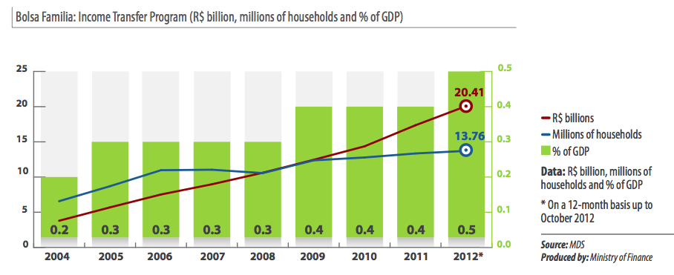
Internal dimension
Income transfer policy: “Bolsa Família”
=> Multiplier effect = 1,78

Slide 10
Internal dimension
Minimum wage policy
Minimum wage in real terms: 1995.05 = 100
Real growth (annual average): 1995-2002 = +4.5%
2003-2010 = +6.6%
MW is an anchor for the revenues
of more than 30 million persons

Slide 11
Internal dimension
Moreover:
Credit policy => public banks role
Credit/GDP: 25% (2003) -> 45% (2010)
Public investments => state companies role
Labor market formalization:
2003 -> 2012: 13 million formal jobs created

Slide 12
Internal dimension
Source: IPEA

Slide 13
Internal dimension
Source: IPEA

Slide 14
Internal dimension
Gini index
Source: IPEA
Notes:
Conferir se o gini está menor do que 0,5

Slide 15
Internal dimension
Source: Neri (2012)

Slide 16
Internal dimension
Income distribution => beyond a social issue: a strong economic engine
A virtuous circle: income distribution & economic growth
A novelty in Brazilian history
Something rare nowadays in the world

Slide 17
Internal dimension
Internalization of the economic dynamism source
Exports – Contribution to GDP growth
Source: IPEA

Slide 18
Internal dimension
Internalization of the economic dynamism source
Households consumption – Contribution to GDP growth
Source: IPEA

Slide 19
Facing the crises
External sector: sudden stop, but sudden reversal (Biancarelli, 2012)
Source: IPEA
Notes:
Gráfico conta financeira

Slide 20
Facing the crises
Economic growth
Source: IBGE

Slide 21
Facing the crises
Unemployment rate (six months average)
Source: IBGE
Notes:
Razoes demográficas e relacionadas às características do crescimento brasileiro: consumo de massas => setores intensivos em mao de obra (servicos)

Slide 22
Final remarks
Are the achievements perennial?
No => They depend on:
Political will
&
Economic growth
Is this model exhausted?
No => But it has to count also on Investments
Public and private
Mainly in infrastructure
Notes:
Nao há contradicao entre consumo e investimento

Slide 23
Final remarks
Brazil is still one of the most unequal countries in the world
Going further on the reduction of this inequalities continues being simultaneously a matter of social justice and an economic engine
This task should be attained through two complementary channels:
Income
Public goods and services

Slide 24
Thank you for your attention
For details:
The Main Trends in the Brazilian Economy over the Last Ten Years
Bruno De Conti
Berlin Working Papers on Money, Finance, Trade and Development – October 2013
brunodeconti@eco.unicamp.br

