Slide 1
Germany’s Economy and the Financial Crises
Fabian Lindner
New Approaches to Economic Challenges: Lessons from the Crisis, 4 Nov 2013

Slide 2
Content
Germany‘s dismal growth in the eurozone
Reasons for its dismal growth
Increase in foreign lending
Employment stabilisation in the Great Depression: Working time reduction and fiscal stimulus
Why Germany profits from the crisis

Slide 3
Very low growth, driven by export surpluses
Average GDP growth rates, 1999-2008:
Source: AMECO

Slide 4
But resilience to the euro crisis

Slide 5
Reasons for low growth
Decrease in real wages – stagnation of consumption
Strong fall in housing investment after housing bubble burst in late 1990s
Very restrictive fiscal policy
2001: Tax cuts for the rich and business
2003: Strong expenditure cuts to balance budget
Decrease in public employment
Strong decrease in public investment – since 2003 decline of public capital stock

Slide 6
Fall in real wages
Percentage change in real compensation per employee, 2000-2010
Source: AMECO

Slide 7
Reasons for wage stagnation
Low internal demand
High unemployment and bankrupcy rates in domestic sectors
No minimum wage
Erosion of collective bargaining coverage
Labour market reforms in times of high unemployment
Liberalisation of forms of employment and employment protection: e.g. agency work, „mini jobs“
Higher pressure on employees through tightening of unemployment insurance
Pressure on low wages, because unemployed have to take work at all wages
Strong increase in low pay sector

Slide 8
Planting the seeds for the financial crisis…
Weak domestic economy – weak domestic credit demand
Foreign lending thrives – Germany is second biggest lender to Euro crisis countries (after France)
German firms sell goods to trade partners
Give receipts to banks – not to employees
Banks lend to today‘s crisis countries
Today‘s crisis countries increase debts, buy German goods -> back to step 1

Slide 9
Germany second biggest creditor of today‘s crisis countries
Source: BIS, own calculations

Slide 10
US crisis hits Germany‘s banks hard
Since 2007 loss of 30 % of net foreign assets, mostly losses due to US crisis
Huge banking rescues
German banks liquidate claims vis-à-vis Eurozone countries –> sudden stop –> euro crisis
Most of the money lent to crisis countries goes back to German (and French) banks (Target balances, Troika loans)

Slide 11
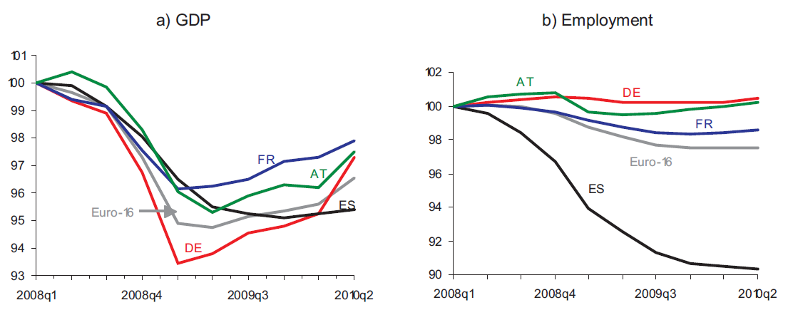
But: employment miracle in the 2008/09 crisis
Source: IMK

Slide 12
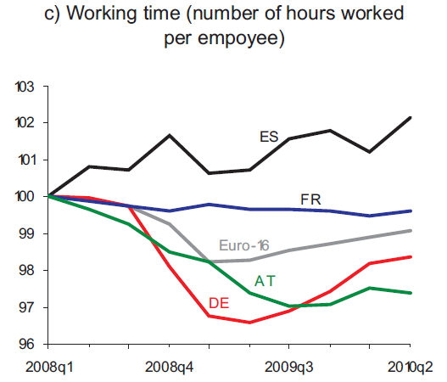
The miracle‘s reasons
Working time reduction through:
Gov. subsidised short time work
Corporatist agreements
Reduction of negotiated weekly working time
Working time accounts
All of them NOT due to labour market reforms!
Stabilized consumption, taxes, domestic demand
Source: IMK

Slide 13
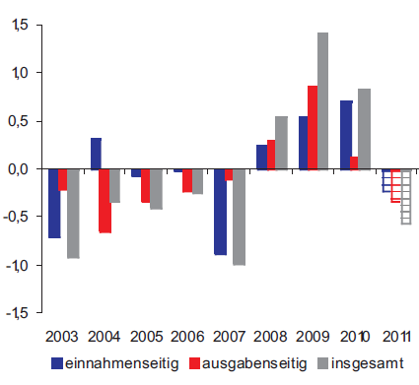
Strongly expansionary fiscal policy in the crisis
Discretionary fiscal impulses in % of GDP
Source: IMK
From revenues
From expenditures
Overall

Slide 14
Economic effects of the eurocrisis for Germany
Fall in euro-exchange rate due to crisis:
higher price-competitiveness for German producers vis-à-vis countries outside the eurozone
Lower long-term interest rates due to capital flight into Germany: Better financing conditions for firms and households
Past export surpluses led to ample corporate profits and thus to high liquid funds for enterprises
High tax growth and low interest rates on led to reduction of government deficit

Slide 15
Luck: Not everyone is so austere
Source: Bundesbank

Slide 16
Lessons
Germany‘s economic policies in the 2000s were contractionary
Only export surpluses (other countries‘ deficits) drove growth
Model is unworkable if applied to all countries
Employment success in the crisis was due to:
Working time reduction
Massive fiscal expansion
Was NOT due to labour market reforms!
Crisis and crisis policies help Germany‘s economy and banks (until now…)
It‘s better to be the creditor and not the debtor in a debt crisis…

