Slide 1
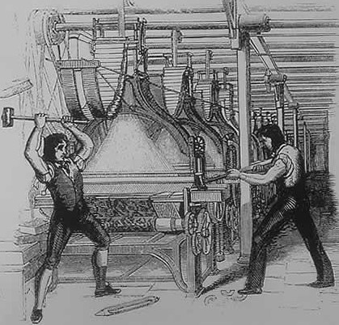
Wolfgang Kowalsky
Trade Union Forum on Digitalisation and the Future of Work
15 February 2017
Paris
Session B: Organising digital workers in the platform economy and beyond

Slide 2
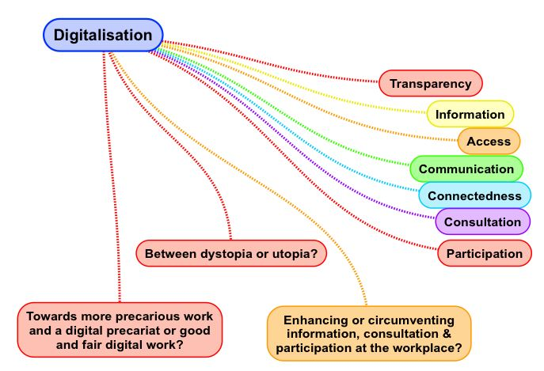

Slide 3
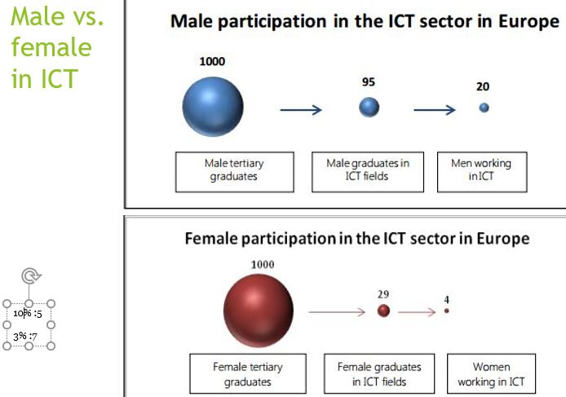
"towards fair digital work“
ETUC resolution on digitalisation 2016:
„to propose an EU framework on crowdworking to prevent the undermining or circumventing of minimum pay rates, working time regulation, social security, pension schemes, taxation, etc., to ensure that national and European regulations and legislation effectively apply to digital crowdworkers in online environments and to ensure the rights of digital workers in online environments; establishing fair rules, ensuring minimum remunerations are paid, giving access to social security”

Slide 4
"towards fair digital work“
Spillover effects on Companies
A dangerous new trend: workforce platforms and crowdworking ‘spilling over’ into many companies: Crowdworking means transferring tasks to a pool of online workers, the “crowd”, via an intermediary, an online platform. Companies get new and easy access to (internal and external) outsourcing through internet platforms advertising to crowdworkers who are supposed to execute different (micro)services or (micro)tasks by simply acknowledging the terms and conditions of the platform.
Two broad categories: internal (inside companies) and external outsourcing.
Transnational external crowdworking is performed outside of the purview of national governments and a general lack of application/enforcement of worker protections can be observed. The labour platforms have significant effect on lowering wages and show worrying signs of a new race to the bottom and increase of social inequalities.

Slide 5
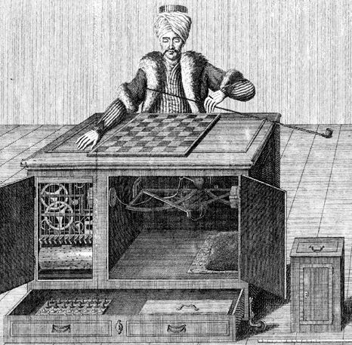
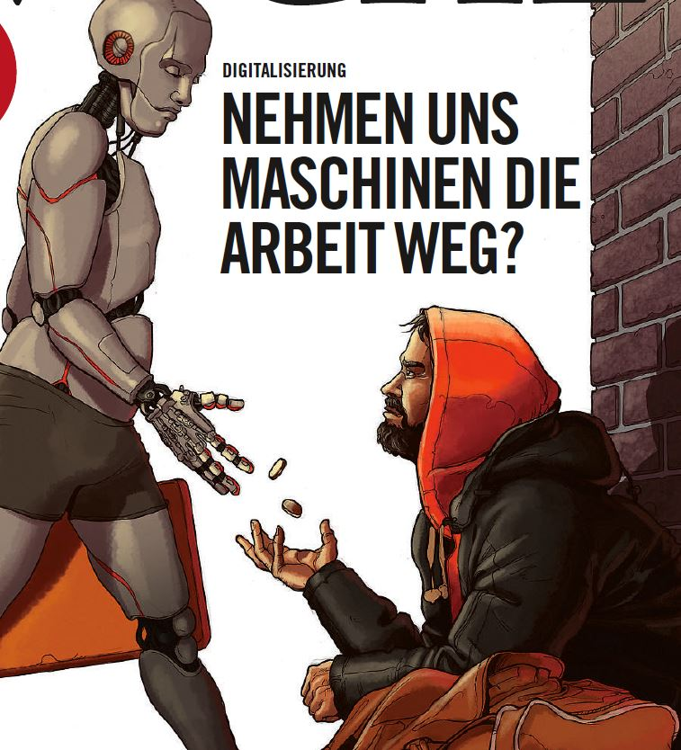
"towards fair digital work“
keys to fair Digital Work
Opportunity to present examples of proactive TU approaches to the digitalisation:
Legal action / litigation strategy - “London approach”
Unionising workers and self-employed – „Paris approach“
Support platforms – „Frankfurt approach“

Slide 6
"towards fair digital work“
EXIT option - What next?
A new crowdworking industry is about to function without the proper recognition of an employment relationship: employment contract, ex-ante agreement on pay, minimum working hours, working time regulation, paid holidays, maternity/paternity leave, social protection etc.
According to the terms and conditions of many workforce platforms only one out of the crowd is paid, it is like a lottery and so the situation is worse than for day-labourers.
Trade union involvement in digitalisation looks like a scattered landscape and is often related to the existing initiatives of Member States – TUs more distanced in MS lagging behind…
Influence companies‘ digitalisation strategies via representative bodies such as EWCs, WCs, Workers reps in company boardrooms …. – influence governmental agenda & European one

Slide 7
