Slide 1
Understanding India’s Economic Slowdown: Global Trend or Local Structural Problems
Professor Amitabh Kundu
TUAC/FES WORKSHOP
NEW APPROACHES TO ECONOMIC CHALLENGES:
LESSONS FROM THE CRISIS
Paris, 4 November 2013

Slide 2
Graph 1 Index of per capita income at constant prices (1950-51=100)

Slide 3
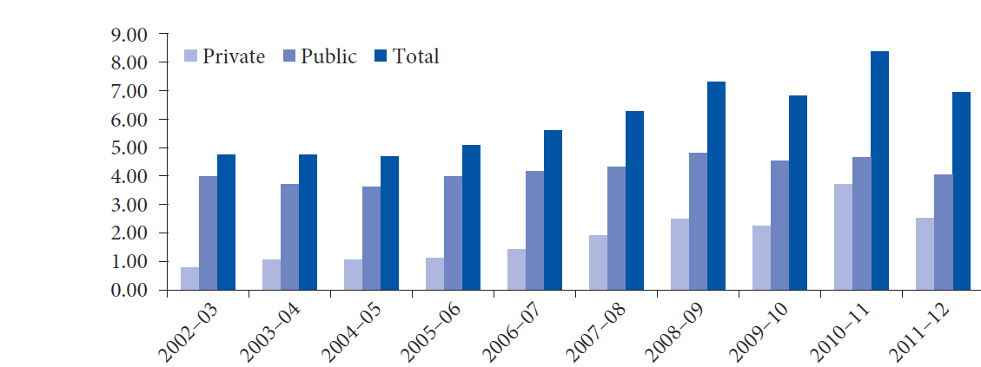
Graph 2: Investment as percentage of GDP

Slide 4
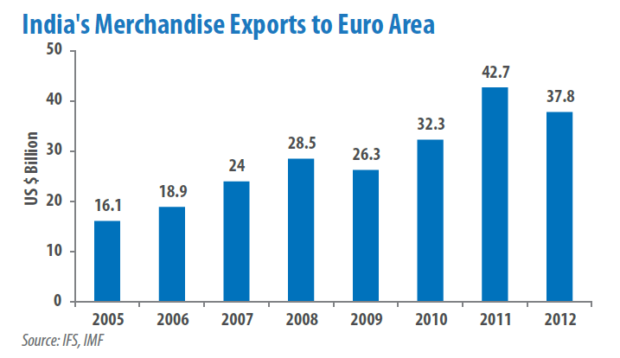

Slide 5
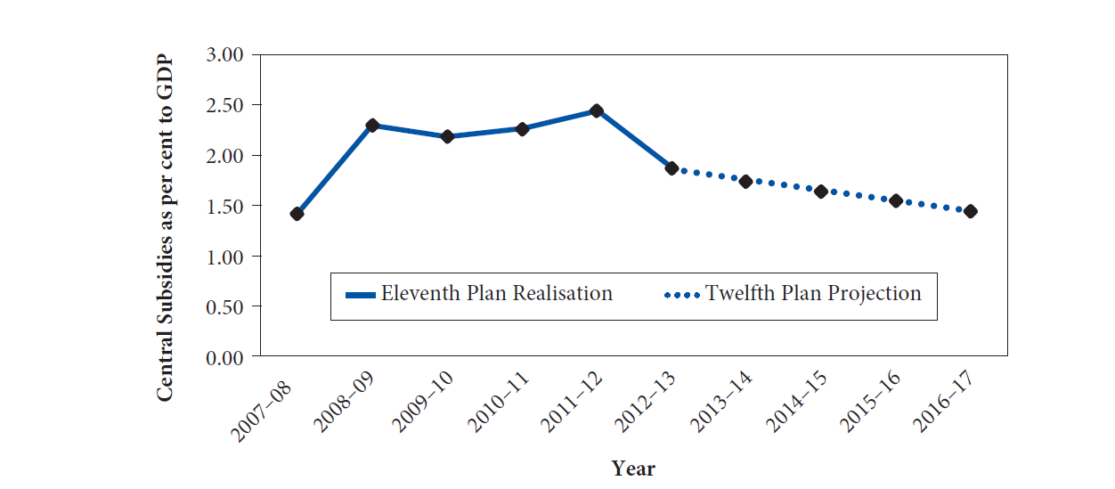
Graph 3: Central Subsidies as a Percentage of GDP

Slide 6
Graph 4 – Proportion of urban population in different size categories

Slide 7
Graph 5 Percentage of Population in Cities with Population over 5 million to Total Urban Population
Europe | Africa | Less Developed Countries | World Average | Developed Countries | Asia | South Central Asia | India
7.5
9
15
15.5
16
18
23
23.5

Slide 8
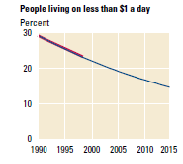
Graph 1: Target and Achievement in Livelihood Related MDG as per GMR 2013
Trends observed also for safe drinking water, slum improvement and gender disparity in primary and secondary education implying meeting the MDG targets

Slide 9
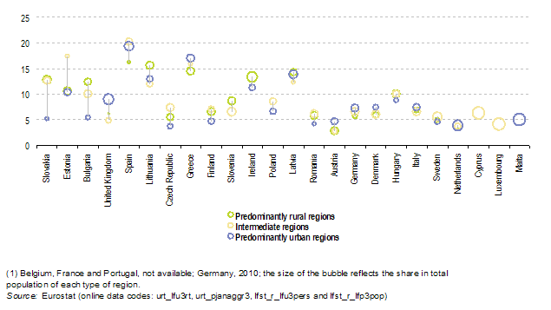
Graph 4: Percentage of Unemployed among persons aged 25 and more by urban–rural typology, 2011 (1)

Slide 10
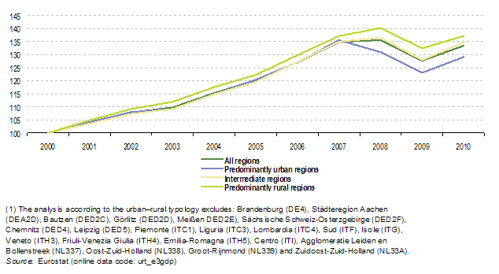
Graph 5: Gross domestic product (GDP), by urban–rural typology, EU-27, 2000–10 (1)

Slide 12
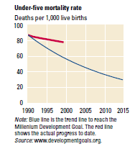
Graph 2: Target and Achievement in Health related MDG
Common trends observed in case of 17 out of 21 MDG targets showing under achievement

Slide 13
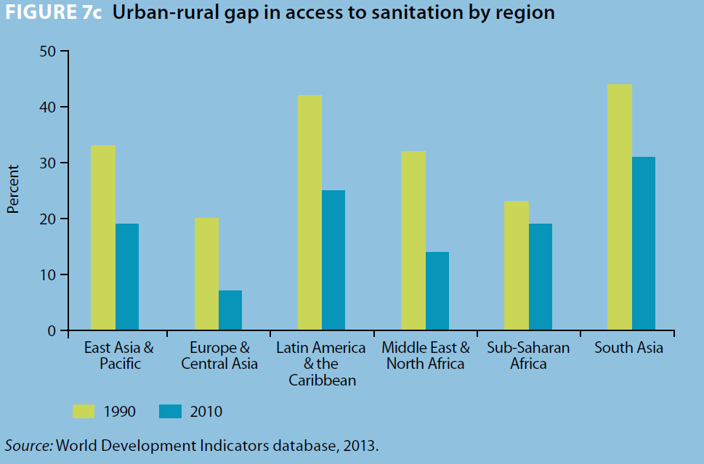

Slide 14
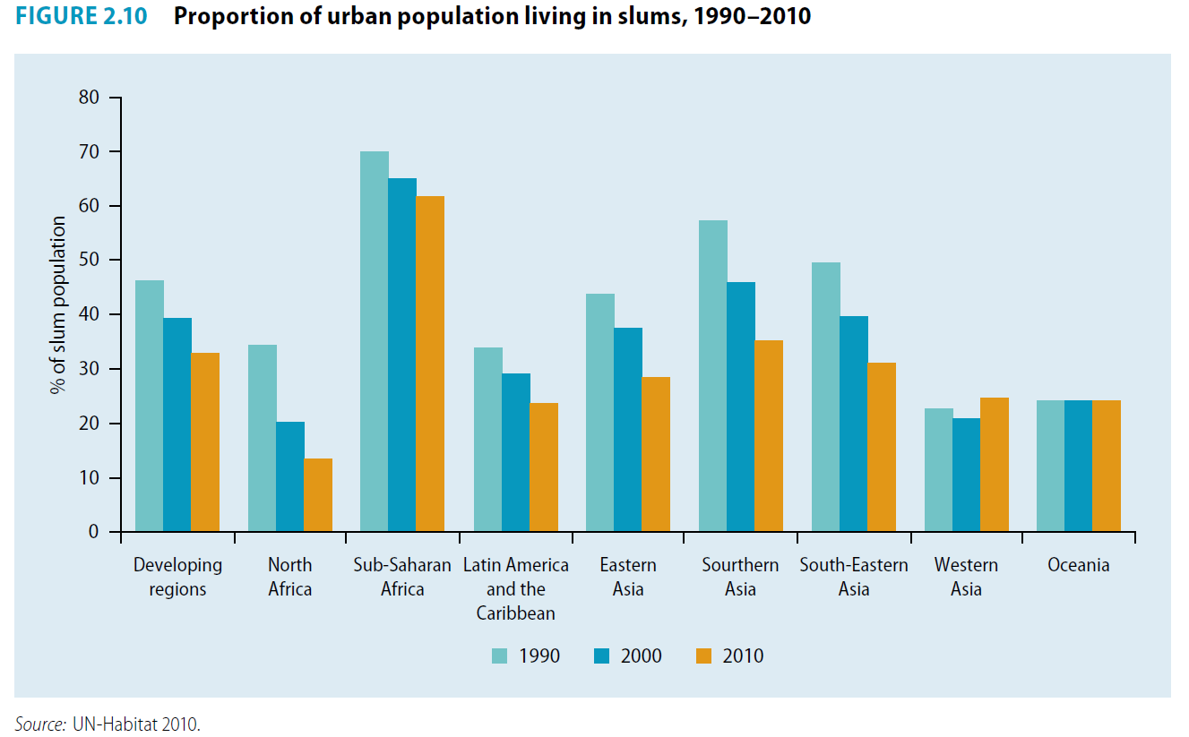

Slide 15
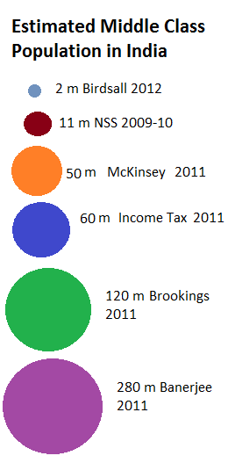
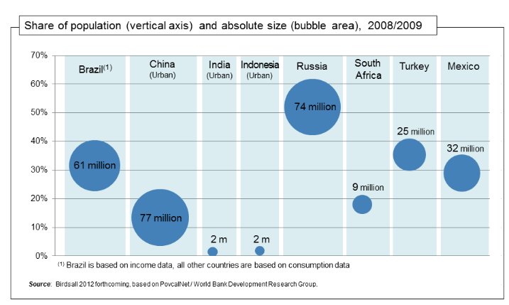
Graph – 11

Slide 18
THANK YOU

