Slide 1
Why do skills matter?
Deborah Roseveare
Head, Skills beyond School Division
6 December 2016
Notes:
Commissioner, ladies and gentlemen.
It’s a great pleasure to be with you today to participate in European vocational skills week.
My task is to set the scene for you by talking about why skills matter and the big challenges we face in rethinking and reshaping adult learning to get better skills outcomes.
There is a great deal that I could say, But I will try to be brief.

Slide 2
Skills transform lives and drive economies
What people know and what they can do has a major impact on their life chances
Building the right skills can help countries improve economic prosperity and social cohesion by supporting:
improvement in productivity and growth
high levels of employment in good quality jobs
social outcomes such as health, civic and social engagement
OECD Skills Strategy (2012)
Notes:
Back in 2012 we did a stocktake of what we knew about skills, drawing together the expertise of OECD across many different sectors.
This stocktake showed convincingly that skills transform lives and drive economies. Skills matter for better economic and social outcomes
For individuals
For societies as a whole
Skills:
support improvement in productivity and growth,
enable high levels of employment in good quality jobs, and
contribute to social outcomes such as health, civil and social engagement.
These are not new findings in themselves and I suspect that everyone win this room is already convinced that skills matter, right?
hat is new is that we realised that improving skills outcomes are not just about getting education or labour markets or economics or regional development policies to work better etc.,
Instead it’s about getting all the different policies and perspectives working together across the whole of society.

Slide 3
A comprehensive approach to skills
OECD Skills Strategy framework
Whole-of-government approach
Engaging all relevant stakeholders
Notes:
The OECD Skills strategy framework helps us to take a comprehensive approach to understand how skills contribute to better economic and social outcomes.
The OECD Skills Strategy emphasises that it’s not just about developing relevant skills.
Because if skills are left lying idle, because people aren’t working, then those skills can’t contribute towards better incomes and outcomes.
And even if skills are being used, they need to be used effectively to generate their full promise of economic prosperity.
So when we are looking at skills we need to look at the whole landscape of the skills system and make sure that skills are leading to better outcomes.
And this is the lens that we use when looking at adult learning.

Slide 4
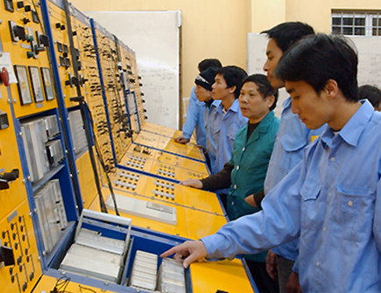
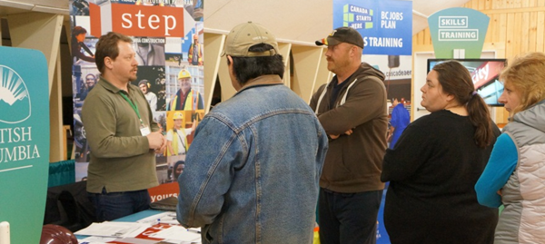
What do we mean by skills (competencies)?
Generic cognitive skills
Technical, professional,
sector-specific skills
Socio-emotional skills
Notes:
Let me just be clear about what we mean by skills, before we go any further, to make sure that we are all on the same page.
There’s a high degree of consensus that a broad range of skills matter for work and for everyday life.
First generic cognitive skills – not only foundation skills, such as literacy and numeracy, but also more advanced skills such as analytical reasoning, critical thinking and problem-solving.
Second, technical, professional and sector-specific skills are needed for jobs today and also for the future (even though jobs and skills needed will evolve over time).
Third, there are socio-emotional skills such as teamwork, communication, creativity, autonomy and self-management, perseverance, initiative, leadership, empathy, etc., etc.
Some people will group these skills differently. That’s ok, because what you call them doesn’t really matter, what matters is that people need a good mix of them. Because weak skills undermine inclusive growth:
People with weak skills can’t participate effectively in today’s labour market and society
Countries with weak skills are held back from making productivity gains, adopting more sophisticated technology and participating effectively in Global Value Chains.

Slide 5
Adult Literacy
Source: Skills Matter 2016, OECD Publishing
Notes:
So let’s take a look at the skills that adults have today.
Although a wide range of skills matter, I want to focus on the skills that are covered by the PIAAC Survey of Adult Skills which has now been conducted across 33 countries in either 2012 or 2015.
This graph shows the distribution of literacy skills across a range of European countries, ordered by the literacy scores of the median adult and showing the range of 80% of the adult population.
The countries on the left side – like Finland and Netherlands -- have much higher literacy skills than those on the right – Greece and Italy.
However it also shows something else that’s very important. Every country has a wide range of literacy skills and every country has some low skilled adults.

Slide 6
Adult numeracy
Source: Skills Matter 2016, OECD Publishing
Notes:
This graph shows the same picture for numeracy skills. Again, all countries have a wide dispersion of numeracy skills and a share of the population with low skills.

Slide 7
Adults with low basic skills
Percentage of adults who score at or below Level 1 in literacy and/or numeracy
Source: Skills Matter 2016, OECD Publishing
Notes:
So let’s look more closely at the first skills challenge that adult learning needs to address – how to help adults with low basic skills, literacy and numeracy to upgrade their skills.
Now in the Survey of Adult Skills, we often also present literacy and numeracy according to proficiency levels that range from less than level 1 up to level 5.
This graph shows the proportion of adults who are at level 1 or less in either literacy or numeracy – or both.
So when we talk about low-skilled adults, we are first and foremost talking about these people. This gives you an idea of the size of the challenge facing countries – even in Finland and the Netherlands, more than 15% of adults have low basic skills.

Slide 8
Educational attainment of adults with low basic skills
Percentage of adults who score at or below Level 1 in literacy and/or numeracy
Source: Skills Matter 2016, OECD Publishing
Notes:
Now we know that there is a correlation between education and literacy and numeracy skills.
And many of those with low basic skills have not completed upper secondary school.
But it’s important to note that a significant share – even a majority of low-skilled in some countries – have actually completed upper secondary school.
And some have even completed a tertiary level programme.

Slide 9
Literacy levels by education attainment
Source: Skills Matter 2016, OECD Publishing
Notes:
Of course it’s also possible to have good literacy and numeracy without having completed secondary school.
As you can see here on average for OECD countries, close to 60% of adults who didn’t complete upper secondary school have literacy skills at level 2 or higher.

Slide 10
Youth NEET rates are especially high for those with low education
NEETs (15-29 years) by level of education, as percentages
NEETs are those Not in Employment, Education or Training
Source: OECD Society at a Glance 2016
Notes:
Now I want to turn to a second challenge for adult learning.
Adult learning can provide a second chance for those not in employment, education and training – the so-called NEETs.
Across OECD, there are around 40 million youth who are NEETs – and a large share of them are inactive – not even looking for work.
Now, one third of these NEETs have -- at most -- completed lower-secondary school and this graph shows, young people with low education are far more likely to be NEETS than those who completed upper secondary school.
We know that these NEETs represent a large challenge for us as societies. Tackling this problem is not only a matter of upgrading their skills – it also requires tackling the full range of obstacles to youth employment.
But giving these young people new opportunities to participate in learning is important too.

Slide 11
Skills in demand
High skilled
1. Software and applications developers and analysts
3. Sales, marketing and public relations professionals
4. Nursing and midwifery professionals
5. Administration professionals
6. Engineering professionals (excluding electrotechnology)
7. Mining, manufacturing and construction supervisors
9. University and higher education teachers
10. Other teaching professionals
12. Business services and administration managers
13. Finance professionals
14. Artistic, cultural and culinary associate professionals
15. Legal professionals
17. Medical and pharmaceutical technicians
18. Administrative and specialised secretaries
19. Other health associate professionals
22. Other health professionals
23. Architects, planners, surveyors and designers
24. Process control technicians
25 occupations with largest employee growth
Notes:
Let me now turn to a third challenge for adult learning:
Enabling adults to develop new skills and respond to changing skill demand throughout their working life.
Now thanks to various European data collections, we have good information on the occupations in demand. I looked at the 25 occupations with the largest employee growth and then grouped them according to their skill classification.
No less than 18 of these occupations are classified as high skilled. Adult learning can play an important role in providing these skills.

Slide 12
Skills in demand
Skilled manual
20. Animal producers
25. Electronics and telecommunications installers and repairers
25 occupations with largest employee growth
Skilled non-manual
2. Personal care workers in health services
8. Material-recording and transport clerks
21. Childcare workers and teachers’ aides
Manual
11. Agricultural, forestry and fishery labourers
16. Other elementary workers
Source: European Vacancy and Recruitment Report 2014, European Commission
Notes:
And of the remaining 7 occupations in the top 25,
All but two of them are skilled occupations.

Slide 13
Evolving skill demand
Technology
Demographics
Global value chains
Changing demand for occupations
Changing skills needed within occupations
New jobs, new occupations
New modes of work
Strong foundation skills
Strong socio-emotional skills
Strong meta-cognitive skills
Notes:
Now let me just say a few words about evolving skill demand because the world won’t simply stand still while we sort out adult learning to tackle these three challenges.
The world itself is being reshaped by many big trends and I would especially highlight three:
Technology
Demographics (including ageing populations and migration flows)
Globalisation and participation in global value chains
These trends will shape the demand for current occupations, the skills needed within occupations and involve new jobs and new occupations. On top of that, the very nature of work is changing with new modes – such as free-lancing -- are becoming more prevalent.
What we do know is that however demand evolves, strong foundation skills will remain important.
So will socio-emotional skills, including resilience, adaptability and flexibility etc.
And also meta-cognition skills – knowing how to learn new skills effectively

Slide 14
Adult learning
Source: Skills Matter 2016, OECD Publishing
Notes:
So now it’s time to look at what adult learning is actually taking place.
If we put together formal and non-formal learning, we can see that many people in the Survey of Adult Skills have participated in adult learning over the previous 12 months.

Slide 15
Participation in formal and/or non-formal education
Literacy
Source: Skills Matter 2016, OECD Publishing
Notes:
But what we see very clearly is that those with higher education and higher skill levels are far more likely to be participating in adult learning. Nearly 80% of those with tertiary education and level4/5 skills had undertaken some form of adult education, but only 20% of those with the weakest skills and education did so.
This is not news – we have know about the so-called “matthew effect” for many years. But here you can really see it at work.

Slide 16
Readiness to learn
Average index of readiness to learn* for people each literacy level
Index of readiness to learn is compiled from responses to questions on the intensity of how they relate new ideas into real life, like learning new things, relate to existing knowledge when coming across something new, get to the bottom of difficult things, figure out how different ideas fit together and look for additional information.
Source: Education at a Glance 2016, OECD Publishing
Notes:
But what we can now go a bit further – we can see that those with higher levels of basic skills are also more “ready to learn”.
Our Index of readiness to learn is compiled from responses to questions in the Survey on the intensity of how respondents:
relate new ideas into real life
like learning new things
relate to existing knowledge when coming across something new
get to the bottom of difficult things
figure out how different ideas fit together; and
look for additional information.

Slide 17
Some implications for adult learning
Major skills challenges :
Raising basic skills for adults
Providing youth who are NEET with skills to succeed
Responding to evolving skill demand
How well is adult learning addressing these skills challenges today?
Lifelong Learning is not yet a reality for most
Adult learning is reinforcing the skills divide
Scale of the challenges suggest new approaches are needed
Notes:
So to summarise the implications for adult learning from the small snapshot of our data, there are three major skills challenges:
[ read slide]
And if we consider how well adult learning is doing in addressing these skills challenges today, then we can see that:
[read slide]

Slide 18
What the future might hold for adult learning
Impact of digitalisation on economies presents even more challenges – and opportunities -- for adult learning
Individuals will take more responsibility for their skills development
Skills may become unbundled with more “just in time”, “just enough”
More emphasis on competencies rather than education
New ways to learn (projects, games, simulation)
More focus on skills for life and for well-being
Notes:
And if we think ahead to what the future might hold for adult learning – the digitalisation of economies and societies presents new challenges but also new opportunities for adult learning
[read slide]

Slide 19
“No-regrets” approaches for an uncertain future
Enable people to easily reskill and upskill throughout their lives
Raise basic skills through a co-ordinated, effective policy approach
Strengthen socio-emotional skills for resilience, adaptability, innovation and inclusion
Notes:
One thing is certain -- that the world will be different in future. So how best to prepare it?
Well we know that if we pursue the following goals, then whatever the future brings we won’t regret having made these investments in our societies and in our future:
Enable people to easily reskill and upskill more easily throughout their lives
Raise basic skills of low-skilled adults through a co-ordinated effective policy approach.
Emphasise and strengthen the socio-emotional skills that underpin resilience and adaptability at the individual level and foster innovation, cohesion and inclusion at the level of societies.
So I hope that this conference will help us all better understand how we can tackle these challenges and work together to achieve better outcomes for all.
Thank you

Slide 20
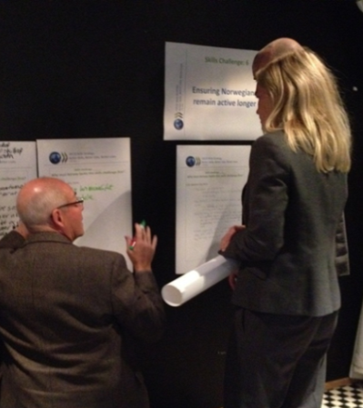
Thank you!
Deborah.Roseveare@oecd.org
www.oecd.org/edu
www.oecd.org/skills

