Slide 1
Corporate Governance in the digital economy
Trade Union Forum on Digitalisation and the Future of Work
16 February 2017 - OECD Conference Center
Héctor Lehuedé
Senior Policy Analyst
OECD Corporate Affairs Division

Slide 2
Topics:
Stock exchanges
Institutional investors & intermediation
Listings
Governance practices of tech giants

Slide 3
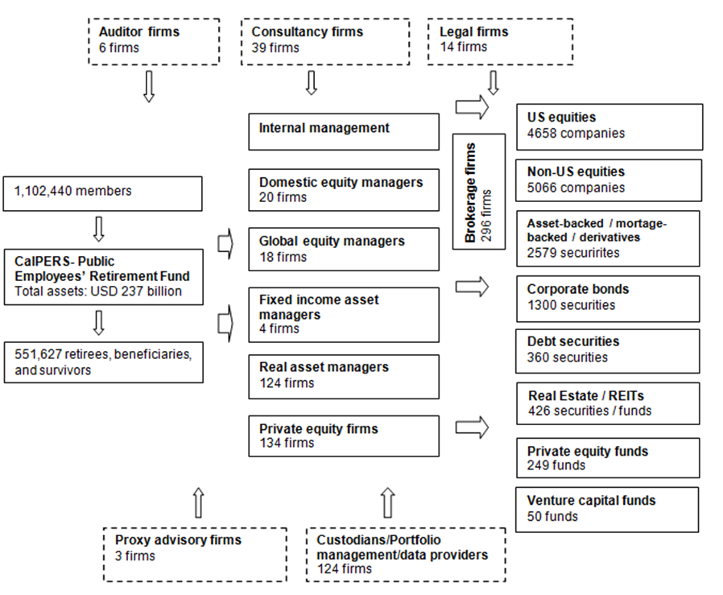
Financial Intermediation Providers
The CalPERS chart (2012)
Source: CalPERS Comprehensive Annual Financial Report, Financial Year Ended June 30, 2012 and CalPERs Annual Investment Report, Financial Year Ended June 30, 2012

Slide 4
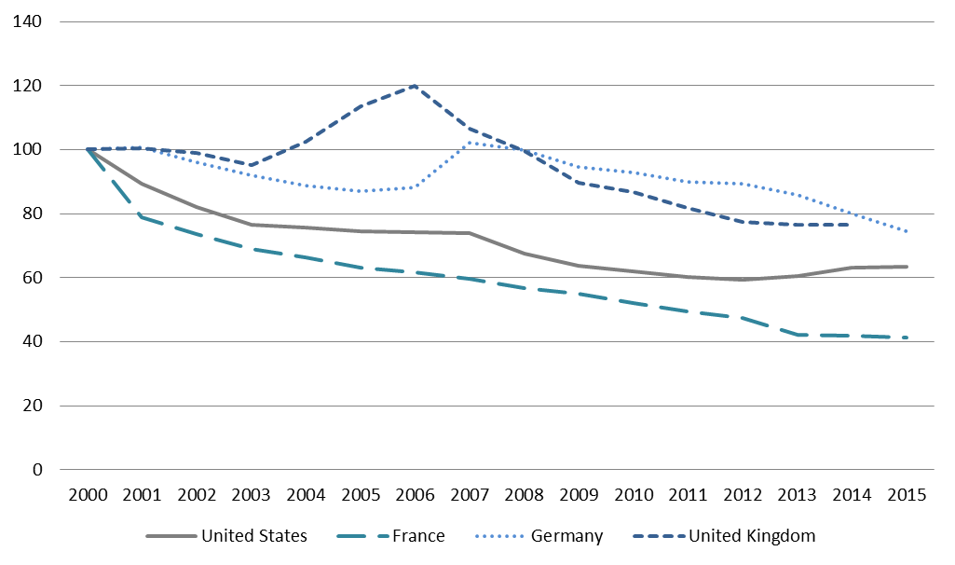
Number of Listed Companies
(Year 2000 = 100)
Source: World Bank World Development Indicators
In the last 10 years, some of the largest and advanced stock markets have lost half of their publicly listed companies. China has doubled.

Slide 5
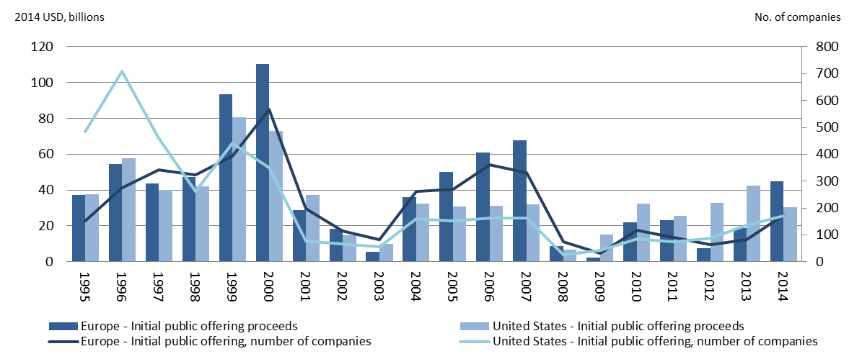
IPOs by Non-Financial Companies
Source: Thomson Reuters, OECD calculations
Annual average number in the US:
1995-2000: 451
2001-2014: 104
Annual average number in Europe:
1995-2000: 343
2001-2014: 160

Slide 6
Financial Intermediation Providers
Look here
The CalPERS case
Source: CalPERS Comprehensive Annual Financial Report, Financial Year Ended June 30, 2012 and CalPERs Annual Investment Report, Financial Year Ended June 30, 2012

Slide 7
The G20/OECD Principles
I. Ensuring the basis of an effective corporate governance framework
II. The rights and equitable treatment of shareholders and key ownership functions
III. Institutional investors, stock markets, and other intermediaries
IV. The role of stakeholders in corporate governance
V. Disclosure and transparency
VI. The responsibilities of the board

Slide 8
Corporate Governance in the digital economy
Trade Union Forum on Digitalisation and the Future of Work
16 February 2017 - OECD Conference Center
Héctor Lehuedé
Senior Policy Analyst
OECD Corporate Affairs Division

